Slide 1
Resources and Layouts
App resources overview | Android Developers

Slide 2
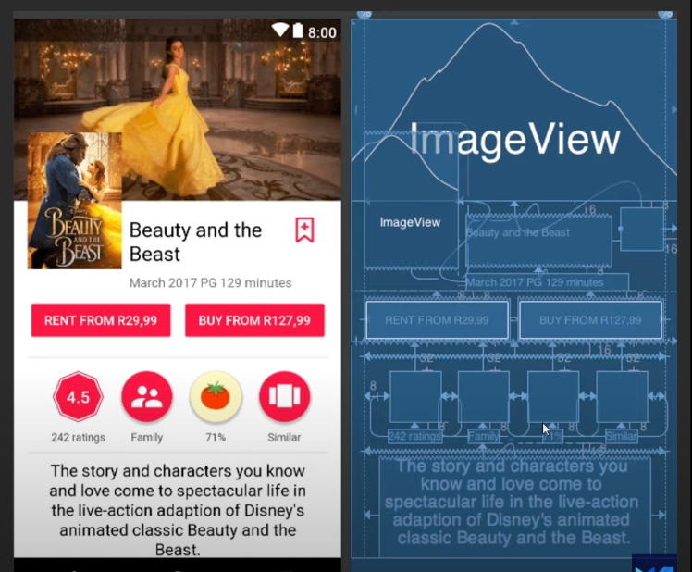
Resources and Layouts
Views
Resources
Inputs

Slide 3
Views
View is the superclass for visual interface elements—a visual component on the screen is a View. Specific types of Views include: TextViews, ImageViews, Buttons, etc.
Like the HTML DOM, Android Views are thus structured into a tree, what is known as the View hierarchy.
Technically, a Layout is simply a ViewGroup that provide “ordering” and “positioning” information for the Views inside of it. Layouts let the system “lay out” the Views intelligently and effectively. Individual views shouldn’t know their own position; this follows from good good object-oriented design and keeps the Views encapsulated.
View | Android Developers

Slide 4
View Properties
android:id specifies a unique identifier for the View. This identifier needs to be unique within the layout, though ideally is unique within the entire app for clarity. whenever you specify a new id, which will allow it to be referenced either from the Java code (as R.id.identifier) or by other XML resources (as @id/identifier).
android:layout_width and android:layout_height are used to specify the View’s size on the screen These values can be a specific value (e.g., 12dp), but more commonly are one of two special values:
  wrap_content, meaning the dimension should be as large as the content requires, plus padding.
  match_parent, meaning the dimension should be as large as the parent (container) element, minus padding. This value was renamed from fill_parent (which has now been deprecated).
Unlike CSS, styling properties specified in the layout XML resources are not inherited. In order to define shared style properties, you’ll need to use styles resources
More: View | Android Developers

Slide 5
Views and Java
Displaying a View on a screen is called inflating that View.
When a View is inflated, it is instantiate as an object. Thus you can think of each XML element as representing a particular Java Object that will be instantiated and referenced at runtime.
You can get a reference to these objects from the Java code using the findViewById() method.
Once you have a reference to a View object in Java, it is possible to specify visual properties dynamically via Java methods
DO NOT instantiate or define Views or View appearances in an Activity’s onCreate() method, unless the properties (e.g., content) truly cannot be determined before runtime! DO specify layouts in the XML instead.
User Interface & Navigation | Android Developers

Slide 6
R
Resources are usually defined as XML. When an application is compiled, the build tools (e.g., Gradle) will generate an additional Java class called R (for “resource”). This class contains what is basically a giant list of static “constants”—at least one for each XML element.
Strings.xml
<string name="app_name">Layout Demo</string>
<string name="greeting">Hello Android!</string>
R File
public class R {
public static class string {
public static final String app_name = "My Application";
public static final String greeting = "Hello Android!";
}
}

Slide 7
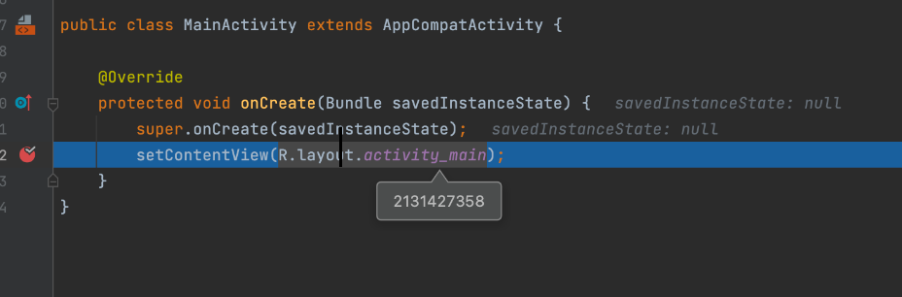
R
Resource can be referred to with R.resource_type.identifier
You can find the generated R.java file inside app/build/generated/source/r/debug/... (Use the Project Files view in Android Studio).
The R class is regenerated all time
Resources res = this.getResources(); //get access to application's resources
String myString = res.getString(R.string.myString); //look up value of that resource
→findViewById
R | Android Developers

Slide 8
DP - SP - PX - PT
Android utilizes the following dimensions or units:
dp is a “density-independent pixel”. On a 160-dpi (dots-per-inch) screen, 1dp equals 1px (pixel). But as dpi increases, the number of pixels per dp increases. These values should be used instead of px, as it allows dimensions to work independent of the hardware’s dpi (which is highly variable).
px is an actual screen pixel. DO NOT USE THIS (use dp instead!)
sp is a “scale-independent pixel”. This value is like dp, but is scaled by the system’s font preference (e.g., if the user has selected that the device should display in a larger font, 1sp will cover more dp). You should always use sp for text dimensions, in order to support user preferences and access
pt is 1/72 of an inch of the physical screen. Similar units mm and in are available. Not recommended for use.

Slide 9
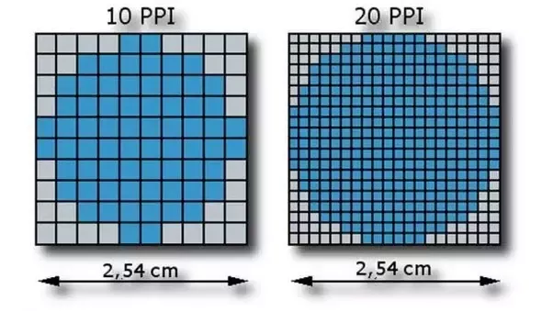
DP - SP - PX - PT
Density Bucket | Screen Density | Physical Size | Pixel Size
ldpi | 120 dpi | 0.5 x 0.5 in | 0.5 in * 120 dpi = 60x60 px
mdpi | 160 dpi | 0.5 x 0.5 in | 0.5 in * 160 dpi = 80x80 px
hdpi | 240 dp | 0.5 x 0.5 in | 0.5 in * 240 dpi = 120x120 px
xhdpi | 320 dpi | 0.5 x 0.5 in | 0.5 in * 320 dpi = 160x160 px
xxhdpi | 480 dpi | 0.5 x 0.5 in | 0.5 in * 480 dpi = 240x240 px
xxxhdpi | 640 dpi | 0.5 x 0.5 in | 0.5 in * 640 dpi = 320x320 px

Slide 10
Resources
Layouts
UI Controls (Buttons,ImageView) (+Programatically)
Graphic Images(image,svg,pdf vs)
Strings, Colors, Fonts
Theme, Style
App resources overview | Android Developers

Slide 11
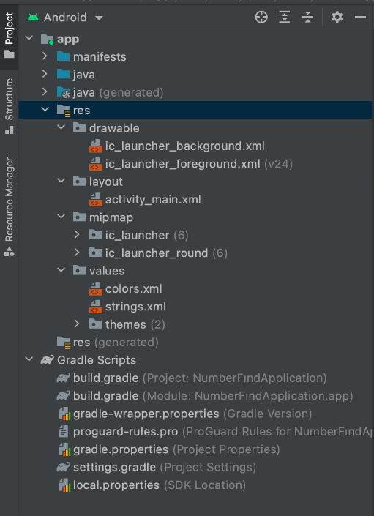
/res
res/drawable: graphs (jpg,png,svg vs)
res/layouts: UI Layouts xml files
res/mipmap: launcher icon files with
different resolution
res/menu
res/animations
res/font
res/values
  strings.xml
  color.xml
  styles.xml
  dimen.xml
Resource types overview | Android Developers

Slide 12
Views - Practice
findViewById
R.drawable.my_image

Slide 13
Layouts
A Layout acts as a container for other Views, to help structure the elements on the screen. Layouts are all subclasses of ViewGroup
  LinearLayout
  RelativeLayout
  ConstraintLayout

Slide 14
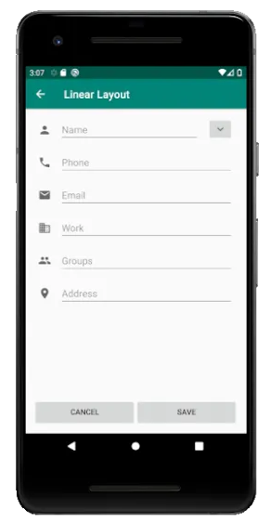
LinearLayout
Orders the children Views in a line (“linearly”).
android:orientation property - Horizontal or Vertical
android:layout_gravity Gravity specifies how a component should be placed in its group of cells.
android:layout_weight Indicates how much of the extra space in the LinearLayout is allocated to the view associated with these LayoutParams.
LinearLayout.LayoutParams | Android Developers

Slide 15
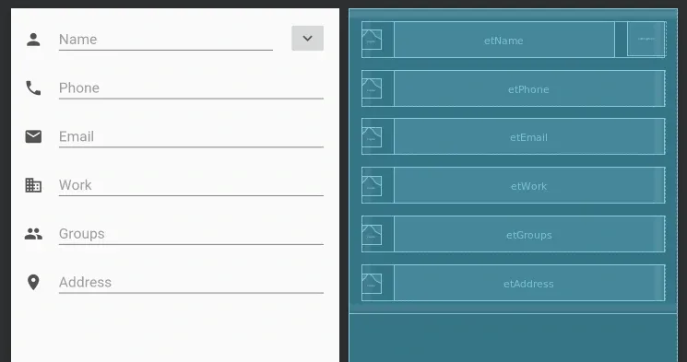
LinearLayout

Slide 16
RelativeLayout
more flexible - more complex
Children are positioned "relative"
Children default to the top-left of the Layout
RelativeLayout.LayoutParams | Android Developers

Slide 17
ConstraintLayout
ConstraintLayout offers a more powerful set of relationships in the form of constraints, which can be used to create highly responsive layouts.
Build a Responsive UI with ConstraintLayout | Android Developers

Slide 18
Other Layouts
FrameLayout
GridLayout
TableLayout
CoordinatorLayout

Slide 19
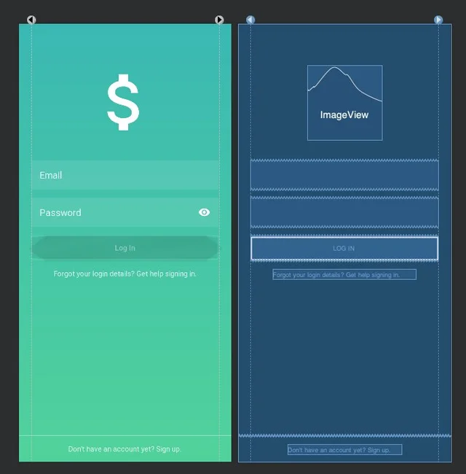
Inputs
Button
EditText
TextView
ImageView
Picker
Spinner

Slide 20
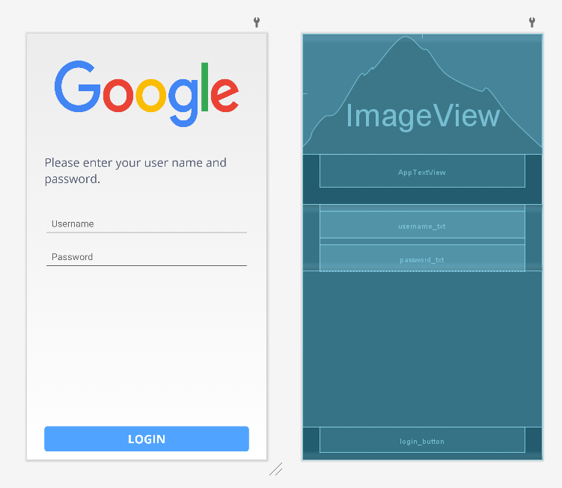
Sample
Login Screen

Slide 21
Homework
Split screen 3-1-3
Middle is TextView
Sides are Button
Add Timer.
When Click Button
  First click start timer
  Second click stop timer
Timer has a limit
Whic player over limit, other player wins the game

